Slide 1
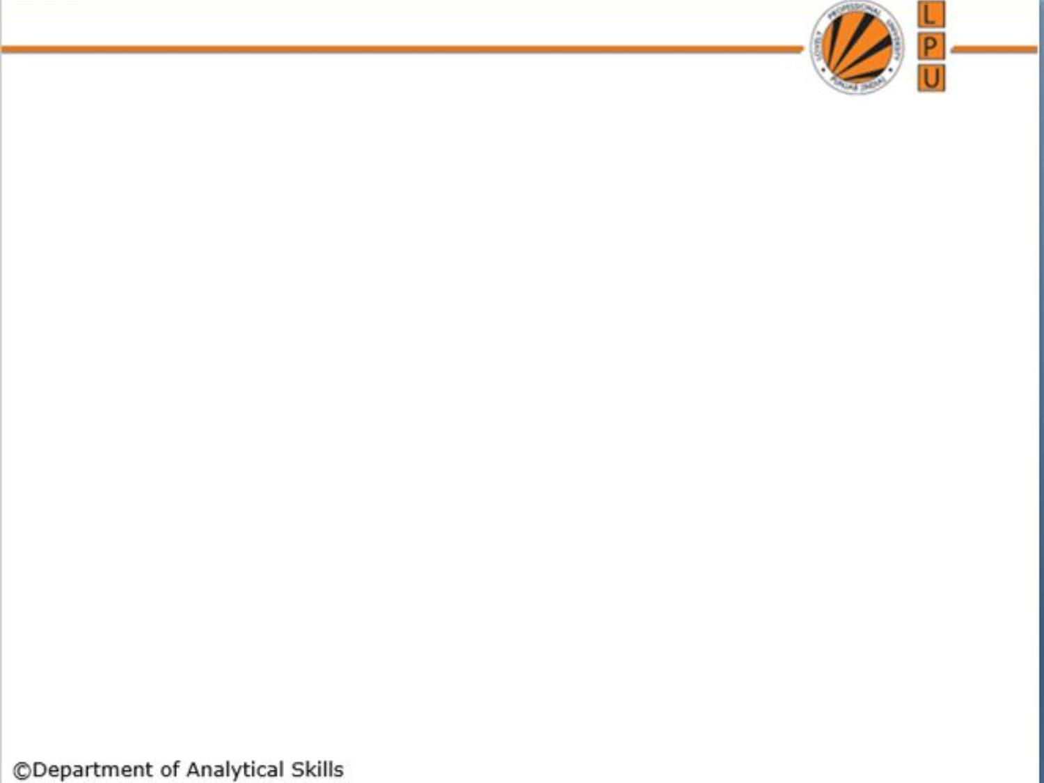
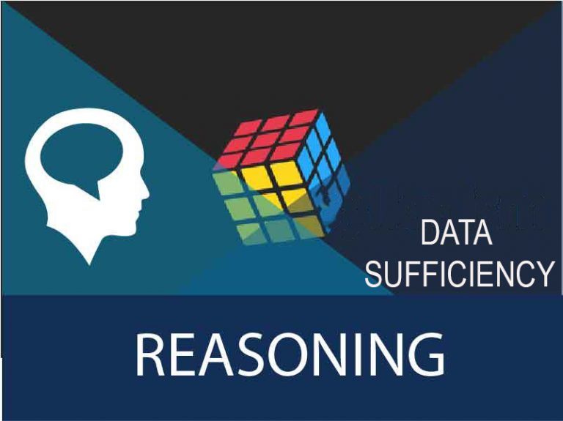
Lecture-23
Data Sufficiency

Slide 2
Content
Concept
Reasoning Based Questions
Quantitative Based Questions

Slide 3
Concept:
In Data sufficiency problems, a question consists of two statements labeled I and II, in which a certain information is given.
You have to decide whether the information given in the statements is sufficient to answer the question or not. you must indicate whether.

Slide 4
Select the correct option
The answer can be obtained from Statement I alone but statement II alone is not sufficient to answer the question asked;
The answer can be obtained from statement II alone but statement I alone is not sufficient to answer the question asked;
The answer can be obtained from both statements I and II together; but neither statement I nor statement II alone is sufficient to answer the question asked ;

Slide 5
We can answer the asked question from either statement I or statement II
We can not answer the question asked from Statement I and II together, and additional information is required to answer the question.

Slide 6
Reasoning Based Questions
1. How many children does M have ?
I. H is the only daughter of X who is wife of M.
II. K and J are brothers of M..

Slide 7
2. The last Sunday of March, 2006 fell on which date ?
The first Sunday of that month fell on 5th.
The last day of that month was Friday.

Slide 8
3. What is the code for 'sky' in the code language ?
I. In the code language, 'sky is clear' is written as 'de ra fa'.
II. In the same code language, 'make it clear' is written as 'de ga jo'..

Slide 9
4. Among five friends P,Q,R,S and T, who ranks 3rd in terms of salary obtained by them?
I. T’s salary is more than P and Q but not more than S.
II. R’s salary is the lowest among them.

Slide 10
5. On which day of the week did Raman leave for Dubai ?
Raman didn’t leave for Dubai during the weekend.
Raman’s brother left for Dubai on Friday 2 days after Raman left for Dubai

Slide 11
6. Among P, K, D and R, who could be the son of M?
I. P and K are sisters
II. D is the mother of K and wife of M.

Slide 12
7. Who among N, F, P, J and D is youngest?
I. P and J are younger than N and D.
II. F is younger than N, D and P but older than J.

Slide 13
8. Who among T, R and S is to the East of P?
I. R, who is to the West of P, is not as near to S as P, S is in the farthest East.
II. P is not as far away from S and T

Slide 14
Quantitative Based Questions
1. What will be the total weight of 10 poles, each of the same weight ?
I. One-fourth of the weight of each pole is 5 kg.
II. The total weight of three poles is 20 kilograms more than the total weight of two poles.

Slide 15
2. How much was the total sale of the company ?
I. The company sold 8000 units of product A each costing Rs. 25.
II. This company has no other product line.

Slide 16
3. Is the average age of the students of a school less than 17 years?
I. The strength of the class VIII is less than 25% of the strength of the school.
II. The average age of the students of class VIII of the school is 18 years and that of the remaining classes is 16 years.

Slide 17
4. What is the three digit number?
I. The three digit number is an exact multiple of 13.
II. The first and the third digit are 7.

Slide 18
5. What is the age of C in a group of A, B, C, D and E whose average is 45 years?
I. Average of the ages of A and B is 53.
II. Average of the ages of D and E is 47.

Slide 19
6. In a library 10% of the books are added every year, what was the number of books that the library had in 1994?
I. During 1996, 10,000 books were added
II. During 1995, the library had 1,00,000 books

Slide 20
7. What is the difference in the ages of P and K?
I. P is 20 years older than M
II. M is 2 years younger than Z

Slide 21


